Slide 1
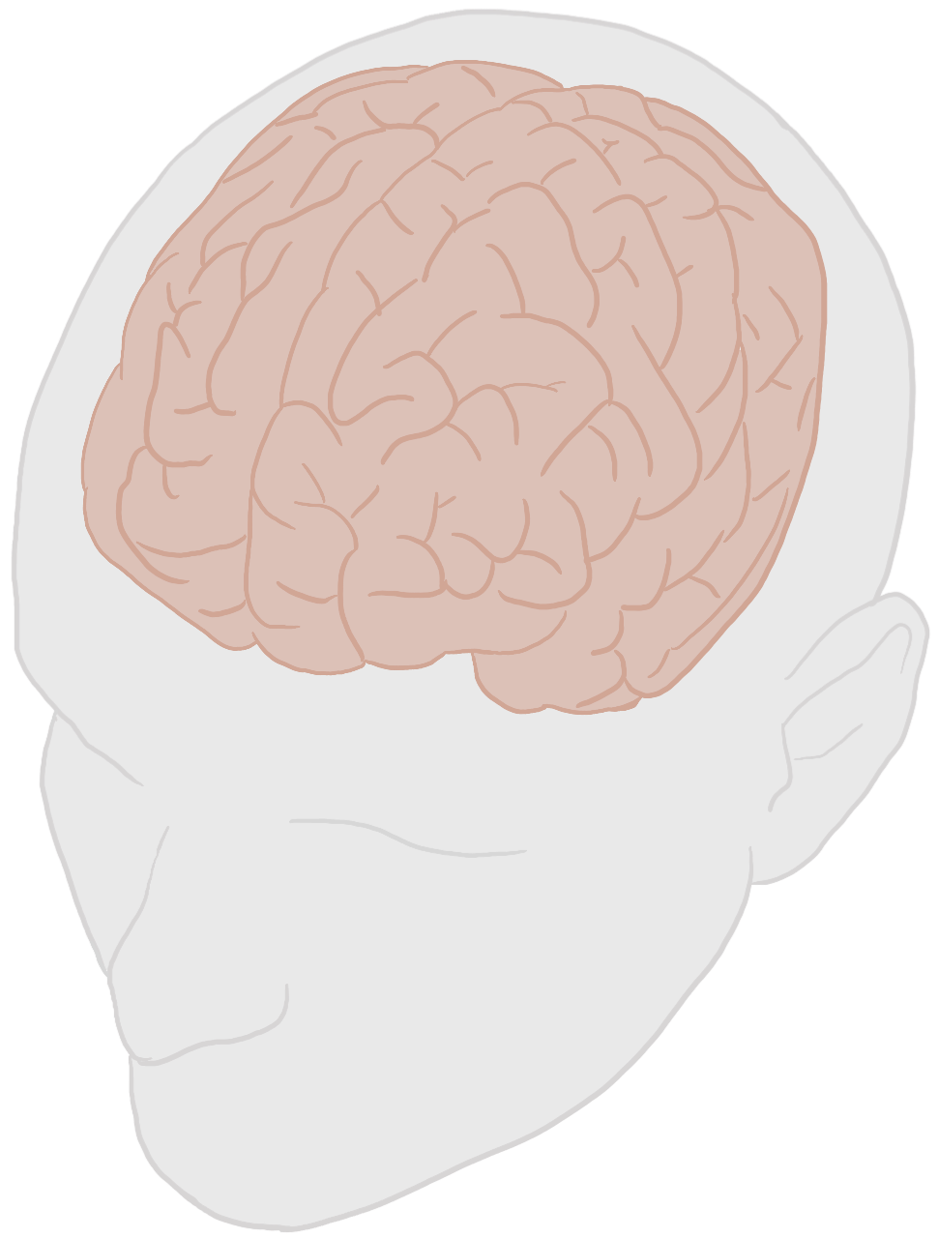
BrainParc: Unified Lifespan Brain Region Parcellation
from Structural MR Images
Intensity Invariant
Cerebrospinal Fluid
Cortical
Lifespan Parcellation
Cerebellum
Infancy
Geriatric
Pediatric
Adolescence
Adulthood

Slide 2
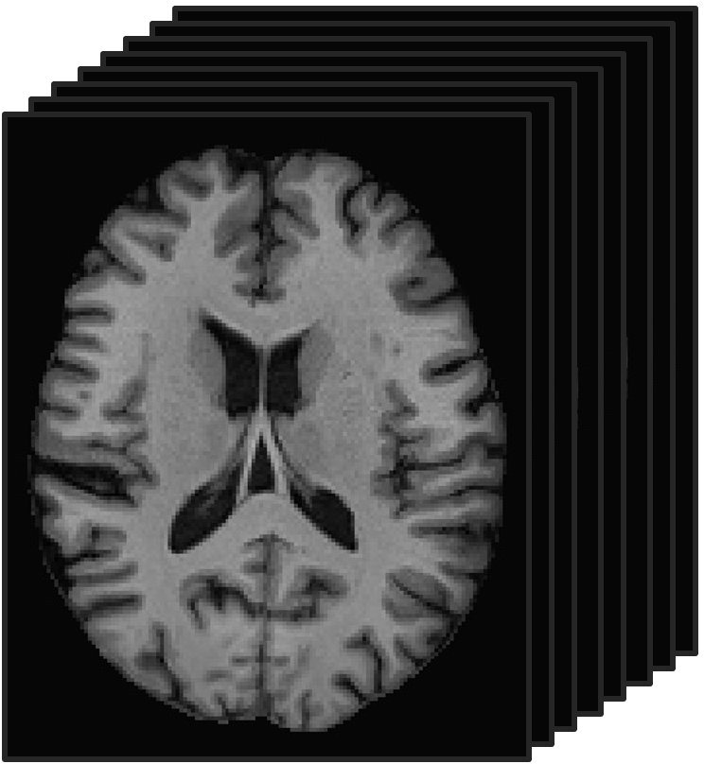
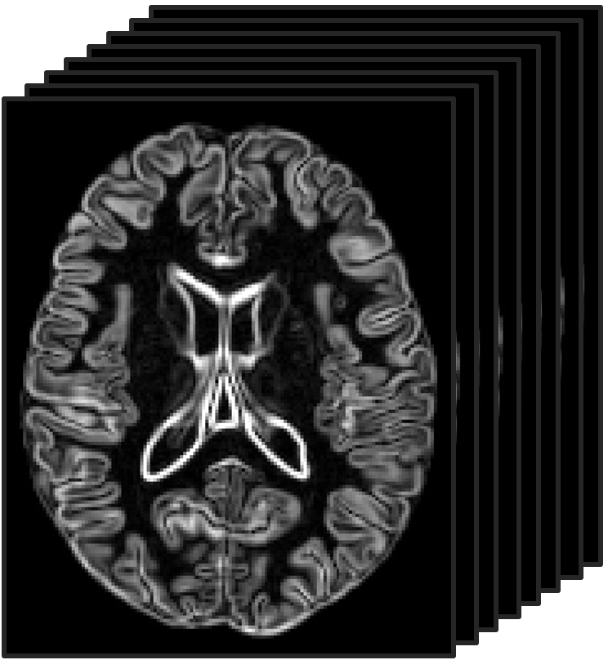
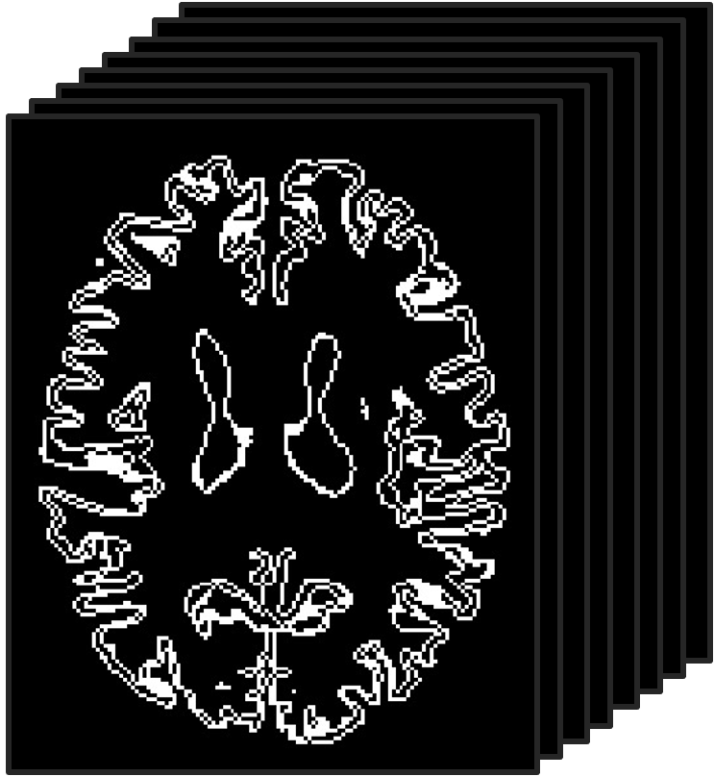





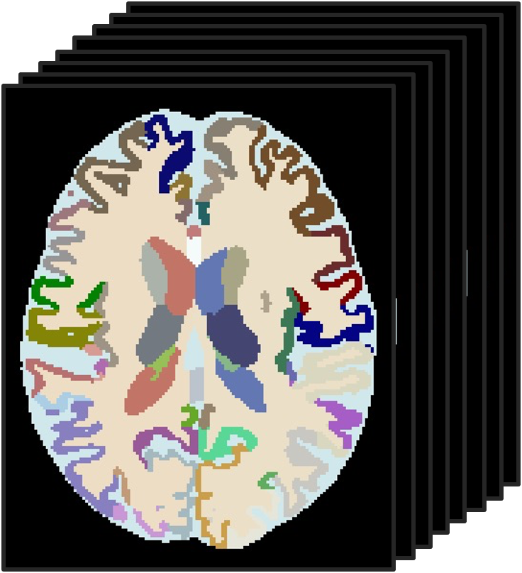



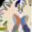


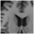


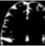

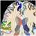
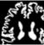

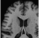

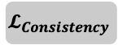
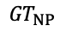
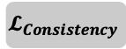
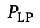
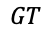
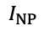
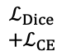
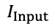
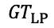

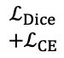
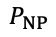
(a)
Boundary Extraction
Tissue Segmentation
Region Parcellation
Sobel
GM
WM
CSF
GM
WM
CSF
C
C
C
ASNet
(Boundary)
ASNet
(Tissue)
ASNet
(Region)
Intensity
Edge map
Tissue boundary
Tissue map
Region
$$𝓛_{Consistency}$$
$$𝓛_{Consistency}$$
(b)
Region Parcellation
(c )
ACF Module
Local Patch Branch
···
···
GM
GM
Crop
$$ℒ_{Dice}$$
$$+ℒ_{CE}$$
Crop
···
$${GT}_{LP}$$
Intensity
WM
WM
$$I_{LP}$$
$$P_{LP}$$
Sobel
C
C
C
ACF Module
ASNet
CSF
CSF
$$I_{Input}$$
···
···
$$GT$$
$$ℒ_{Dice}$$
$$+ℒ_{CE}$$
Resize
Resize
Tissue
boundary
Tissue
map
Neighborhood Patch
Branch
···
Edge map
$$I_{NP}$$
$$P_{NP}$$
$${GT}_{NP}$$
GM: Gray Matter
WM: White Matter
CSF: Cerebrospinal Fluid
LP: Local Patch
NP: Neighboring Patch
ACF: Attention-based Cross-branch Fusion

